Slide 1


Agentic AI Hackathon: Building Intelligent Agents with IBM Granite and LangFlow
Problem statement
Agentic AI System for Explainable Traffic Congestion Analysis

Slide 2



Name of the team: ThinkAI
Details of Team members
TEAM MEMBER NAME | Recent Passport Photo | Email ID | Phone number [WhatsApp]
GAGANA R
gaganaravi19@gmail.com
8867324199
M G SAHANA
sahanagowda27j@gmail.com
7975743923
PRIYA H M
priyahm271@gmail.com
74066 84059

Slide 3
Problem statement
Agentic AI System for Explainable Traffic Congestion Analysis
The Challenge
Traffic operators receive congestion alerts, but lack clear explanationof why congestion occurs, leading to delayed decisions, reduced trust, and inefficient traffic management.
Key Gaps in Existing Systems
Detection without explanation – Systems show congestion but do not explain contributing factors
Lack of context awareness – Time, location, weather, and situational factors are not reasoned together
Fragmented and unreliable insights – Data scattered across sources makes decisions hard to trust
Poor real-time interpretability – Dynamic changes (rain, accidents, peak hours) are not explained clearly
Decision inefficiency – Operators spend time interpreting data nstead of acting on insights
Need
An explainable, agent-based AI system that reasons over traffic data and provides clear, human-understandable explanations to support faster and more reliable traffic decisions.

Slide 4
Proposed solution
Explainable Agentic AI System
A multi-agent AI architecture designed to reason step-by-step, similar to how human traffic operators analyze congestion
Specialized agents independently analyze traffic signals, causal factors, and contextual conditions, improving transparency
Built using IBM watsonx.ai and Granite foundation models for reliable, instruction-driven reasoning
Integrates Retrieval Augmented Generation (RAG) to ground explanations in verified traffic knowledge
Delivers:
Structured outputs for system integration and automation
Human-readable explanations to support operator decision-making

Slide 5
Need of the Project
Urban traffic systems can detect congestion but fail to explain why it occurs
Traffic operators still rely on manual interpretation, slowing down decision-making
Existing solutions focus on visualization, not reasoning or causality
Lack of explainability leads to:
Delayed responses
Inefficient traffic management
Reduced trust in automated systems
There is a need for an explainable AI system that:
Analyzes traffic data contextually
Identifies root causes of congestion
Provides clear, human-readable explanations
Therefore, this project bridges the gap between traffic congestion detection and actionable, explainable intelligence for smarter urban mobility.

Slide 6
End user of project
Traffic Control Authorities
Use explainable congestion insights to take timely operational actions such as signal optimization, diversions, and incident management.
Smart City Administrators & Urban Planners
Leverage transparent traffic explanations to analyze congestion patterns and plan long-term infrastructure and mobility strategies.
Emergency Response & Law Enforcement Teams
Gain rapid clarity on congestion causes to plan faster routes and coordinate emergency responses effectively.
Public Transport Operators
Optimize routes, schedules, and fleet deployment using congestion-aware, explainable insights.
City Governance & Policy Makers
Rely on explainable AI outputs for accountable decision-making, policy formulation, and public trust.

Slide 7
Technology Used
IBM watsonx.ai
Enterprise-grade AI platform used to run, manage, and deploy foundation models with reliability and governance.
IBM Granite 3-3-70B Instruct
Large-scale instruction-tuned foundation model enabling step-by-step, explainable reasoning across traffic scenarios.
Langflow
Visual orchestration framework used to design and manage a multi-agent AI system with clear reasoning pipelines.
Astra DB (Vector Database)
Stores and retrieves traffic knowledge using embeddings, enabling context-aware and grounded AI responses.
Retrieval Augmented Generation (RAG)
Ensures AI outputs are grounded in verified traffic documents, improving trust and reducing hallucinations.
Prompt Templates & Agents
Enforces structured reasoning, role-based analysis, and human-readable explanations.

Slide 8
Novelty and Uniqueness
Agentic AI over Monolithic Models
Uses multiple specialized AI agents for traffic understanding, causal analysis, and explanation — unlike traditional single-model systems.
Explainability-First Design
Designed with explanation as a core principle, ensuring every congestion insight is accompanied by clear reasoning.
Structured + Human-Readable Outputs
Produces structured outputs for systems and natural-language explanations for human decision-makers.
IBM-Native, Responsible AI Approach
Built entirely using IBM watsonx.ai and Granite models, aligning with IBM’s Responsible AI principles for public-sector readiness.
Context-Aware Traffic Intelligence
Considers time, location, and situational context instead of generating generic congestion alerts.
Scalable and Modular Architecture
Agent-based design enables easy extension across cities, data sources, and use cases without redesign.

Slide 9
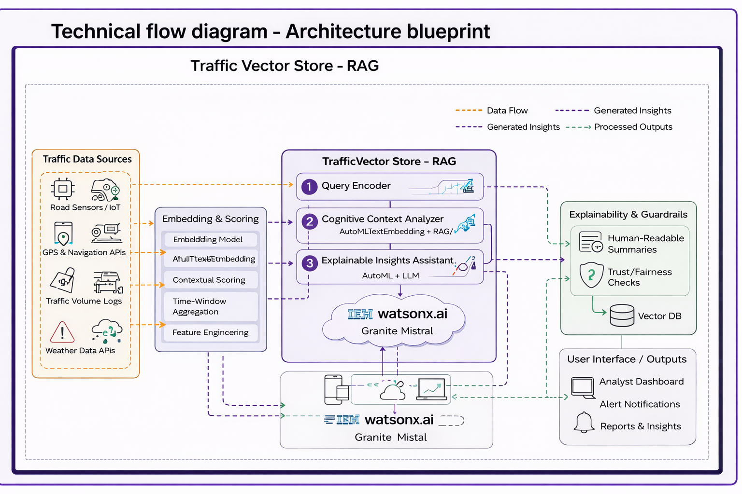
Technical flow diagram - Architecture blueprint

Slide 10
Langflow component Used
Chat Input
Captures user traffic-related queries in natural language
Prompt Template
Structures user input to guide focused, context-aware reasoning
Embedding Model (IBM Granite Embeddings)
Converts traffic documents and user queries into semantic vectors
Astra DB
Stores and retrieves relevant traffic knowledge using vector similarity
Parser (Stringify)
Transforms retrieved data into readable context for reasoning
Language Model (IBM Granite)
Performs controlled analytical reasoning and explanation generation
Traffic Data Analyzer (Agent)
Identifies congestion indicators and traffic patterns
Congestion Cause Analyzer (Agent)
Determines underlying causes of congestion through causal analysis
Explainable Insight Assistant (Agent)
Converts technical analysis into clear, human-readable explanations
Chat Output
Presents the final explainable traffic insights to the user

Slide 11
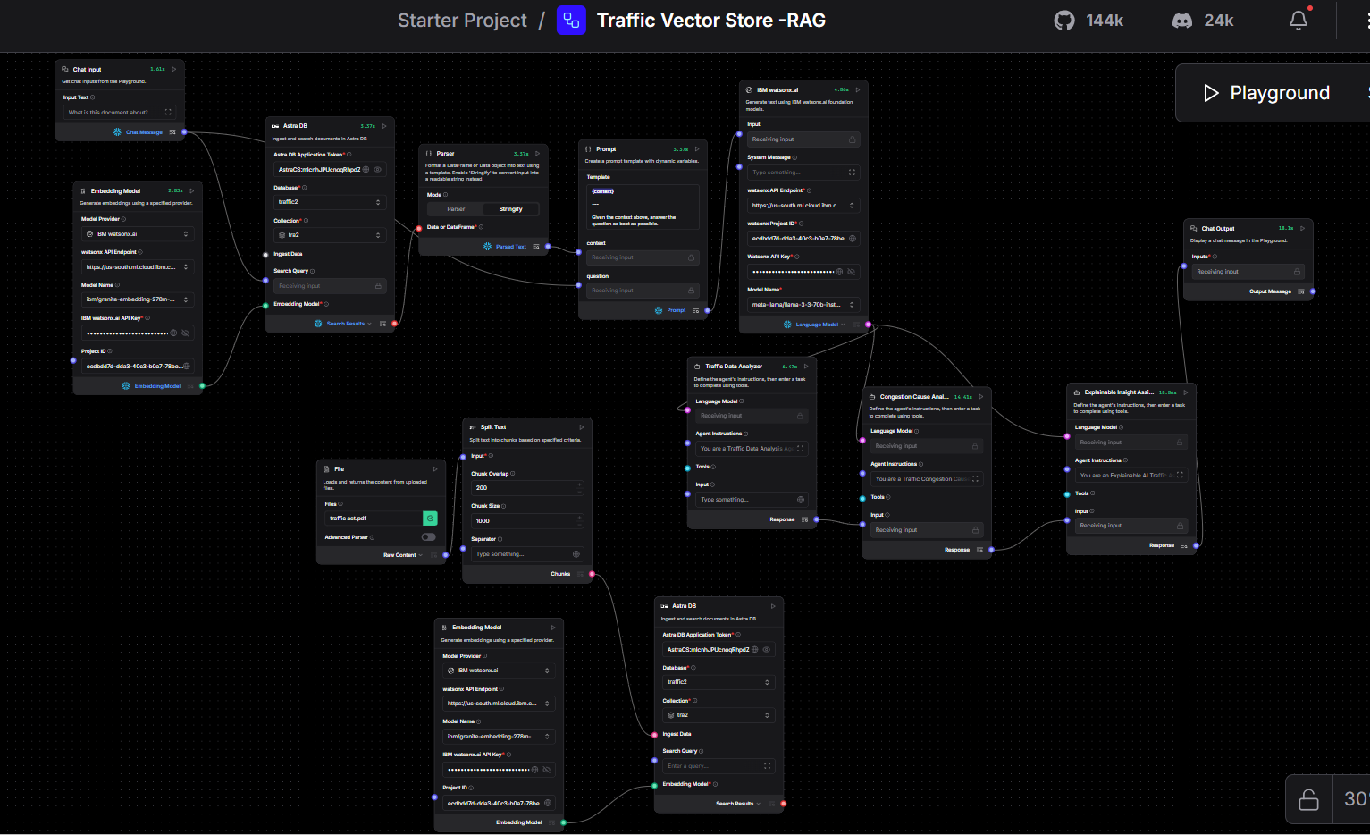
Input Screenshot-1

Slide 12
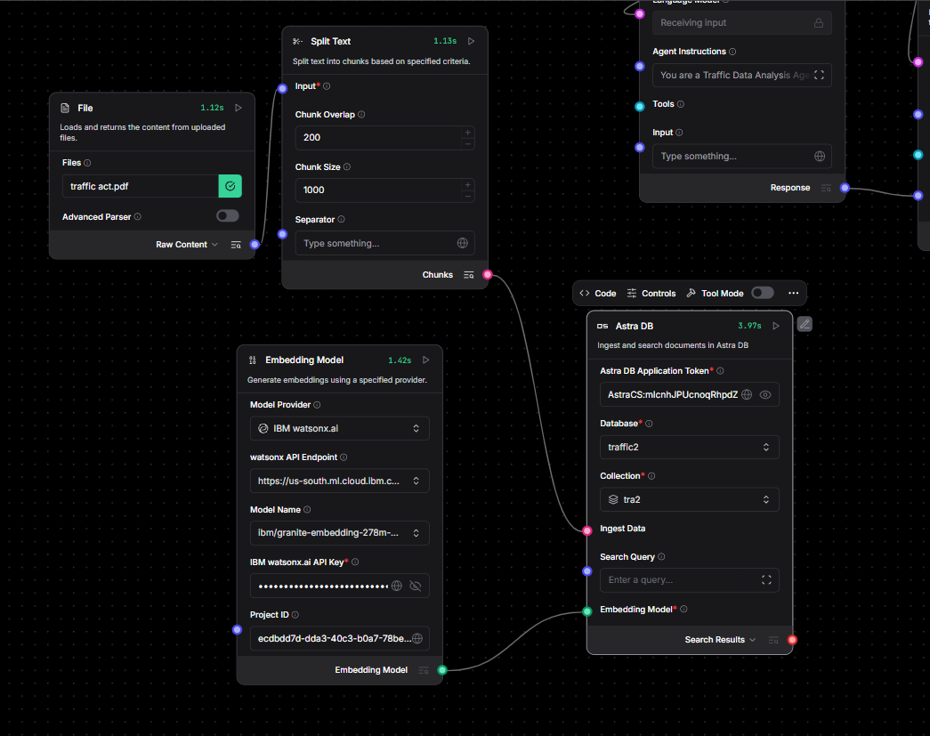
Input Screenshot-2

Slide 13
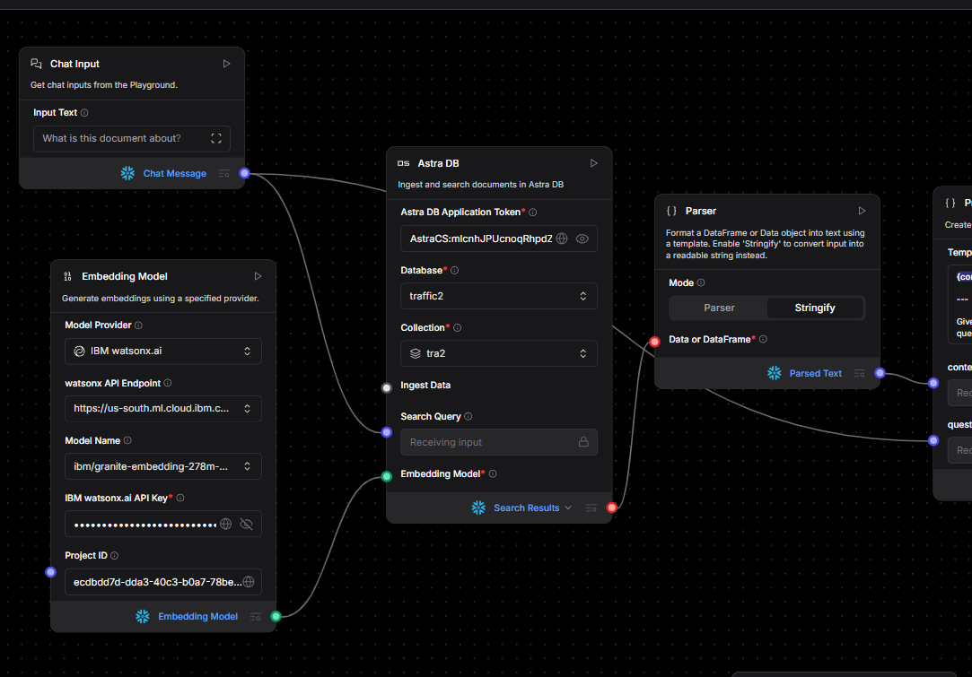
Input Screenshot-3

Slide 14
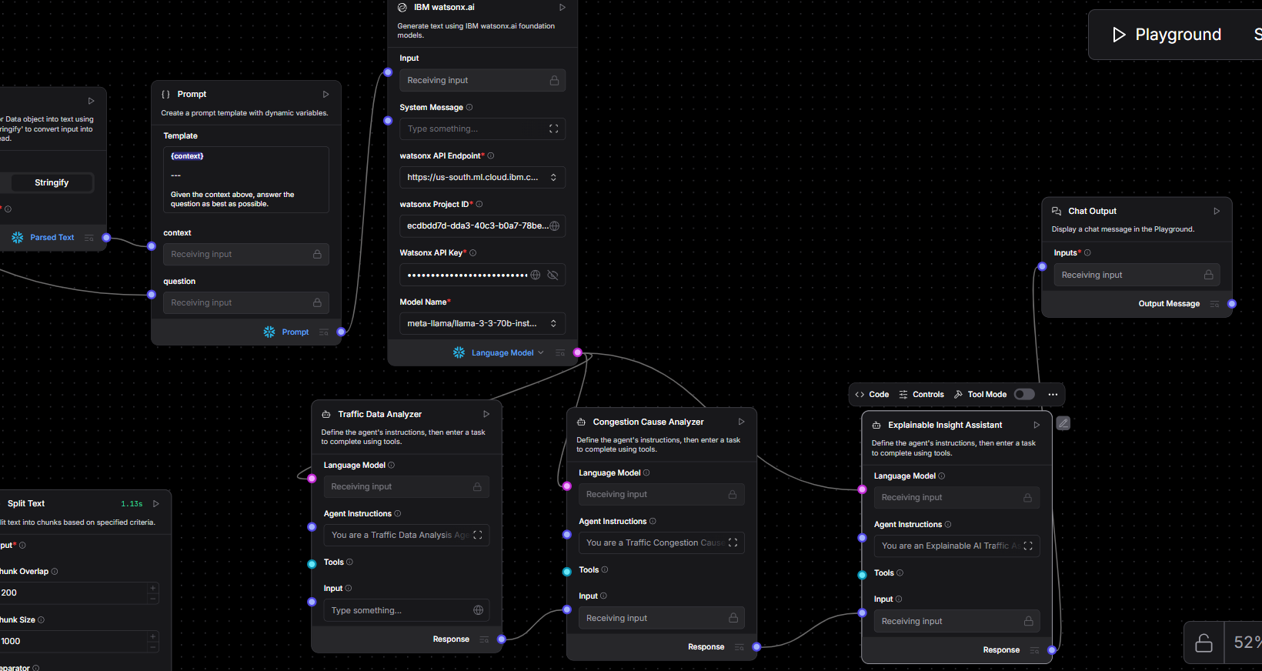
Input Screenshot-4

Slide 15

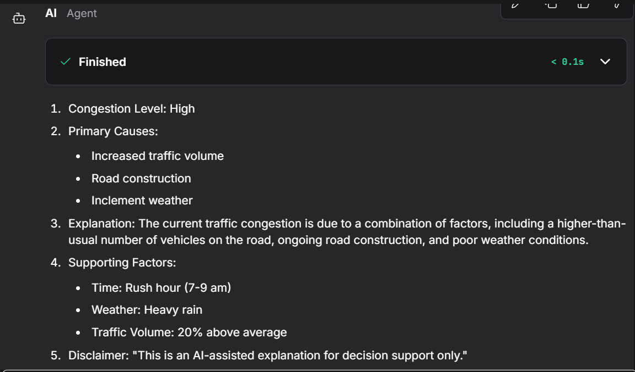
Output Screenshot 1

Slide 16

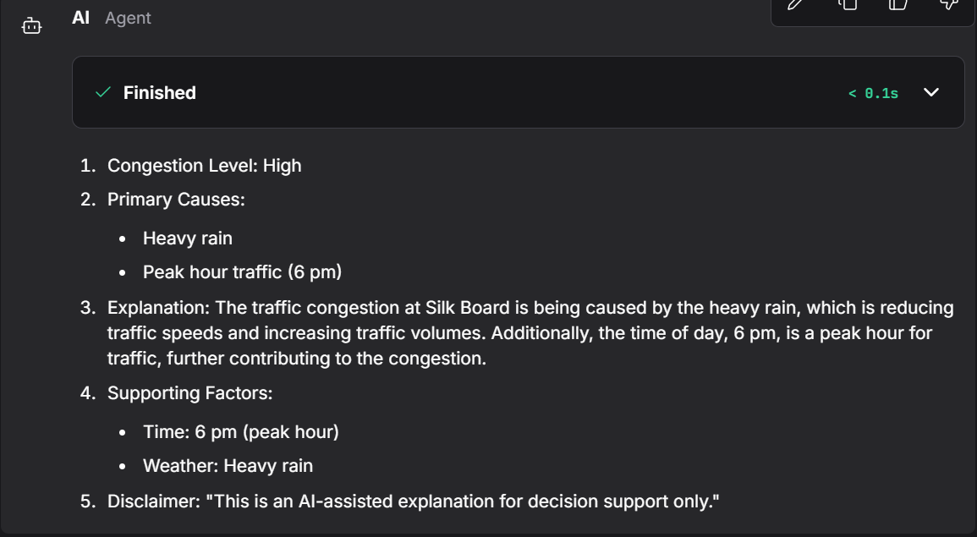
Output Screenshot 2

Slide 17
Future Scope
Real-Time Explainable Traffic Analysis
Integrating live data from traffic sensors, GPS systems, and IoT devices to generate real-time congestion explanations, not just alerts.
Context-Aware Intelligence
Incorporating weather conditions, public events, roadworks, and incidents to enhance cause-based traffic reasoning.
Predictive & Preventive Insights
Extending the system to forecast congestion trends and explain future risks using historical and temporal patterns.
City-Level Decision Dashboards
Visualizing explainable traffic insights for traffic control rooms and urban planners to support data-driven interventions.
Scalable Multi-City Deployment
Adapting the system for multiple cities with configurable traffic rules and infrastructure models.
Sustainability & Emergency Support
Linking congestion analysis with emission estimates and enabling explainable routing insights for emergency services.
·

Slide 18
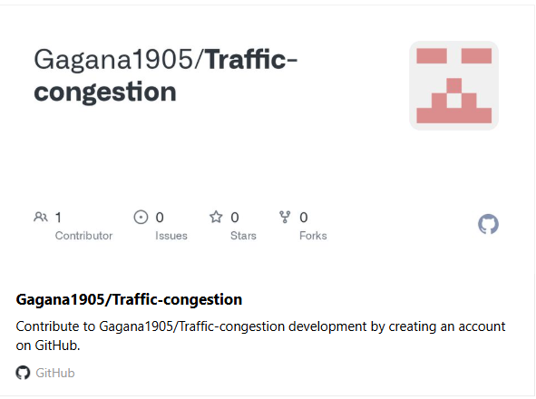
Git Hub Link
link : https://github.com/Gagana1905/Traffic-congestion

Slide 19
References
IBM watsonx.ai Documentation
IBM Corporation. watsonx.ai – Foundation Models and AI Studio.
https://www.ibm.com/products/watsonx-ai
IBM Granite Foundation Models
IBM Research. Granite Foundation Models for Enterprise AI.
https://www.ibm.com/watsonx/granite
Langflow Documentation
Langflow. Visual Framework for LLM-powered and Agentic AI Applications.
https://docs.langflow.org
Urban Traffic Congestion Studies
Federal Highway Administration (FHWA). Traffic Congestion and Reliability.
https://ops.fhwa.dot.gov/congestion_report

Slide 20


